Slide 1
SURVEY – student 2024
DCD Paediatric Dentistry 2024
January 7th 2025, 1:13 pm AEDT

Slide 2
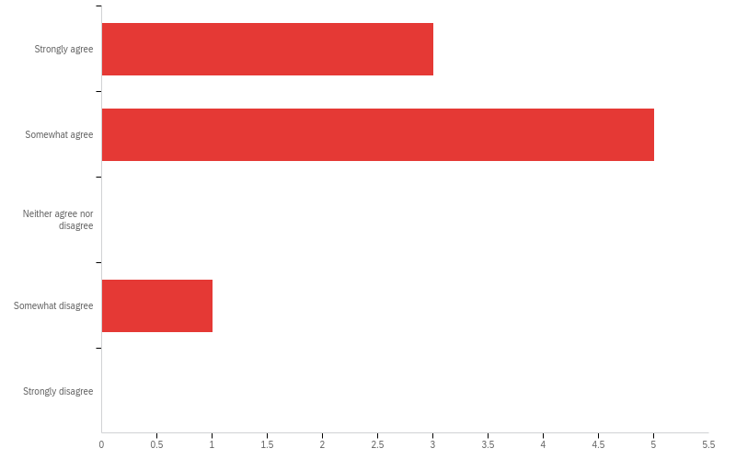
Q1 - There were sufficient patients with a broad range of conditions to contribute to my learning

Slide 3
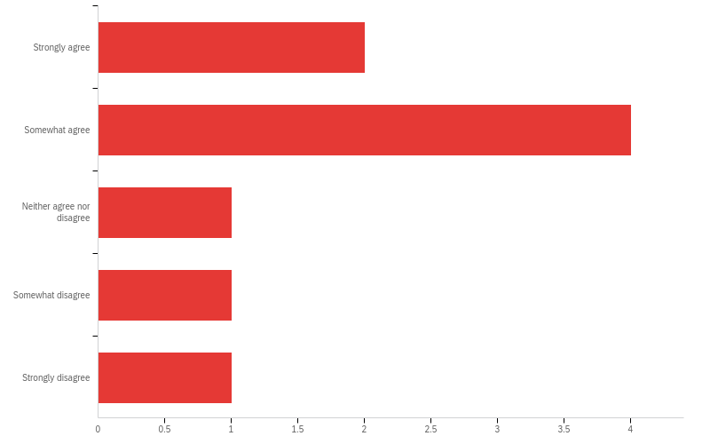
Q2 - There was sufficient chairside assistance in each of the clinical settings to allow me to work efficiently

Slide 4
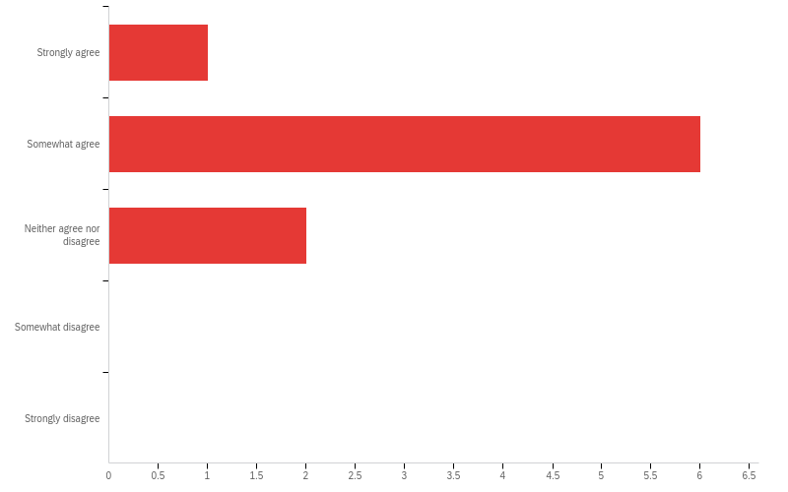
Q3 - The equipment and materials in each of the clinical settings was appropriate for patient care

Slide 5
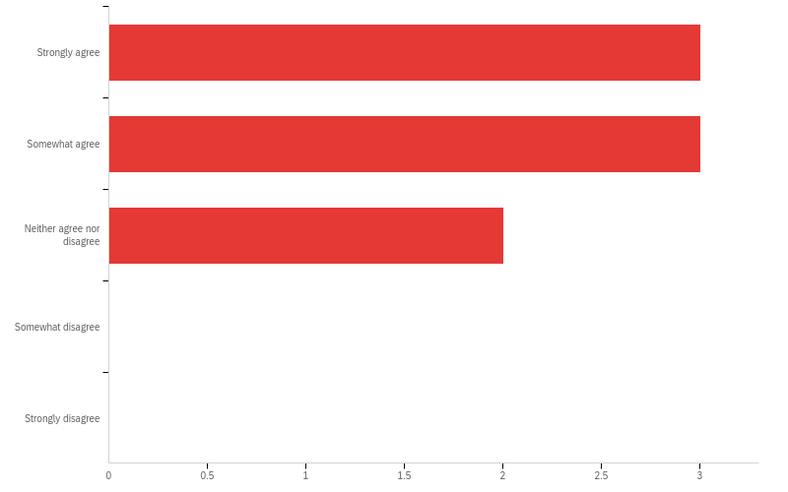
Q4 - Dr. Cheney was readily available

Slide 6
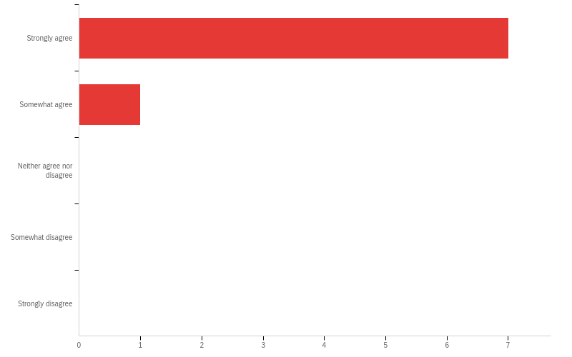
Q5 - Dr. Cheney was patient with my learning

Slide 7
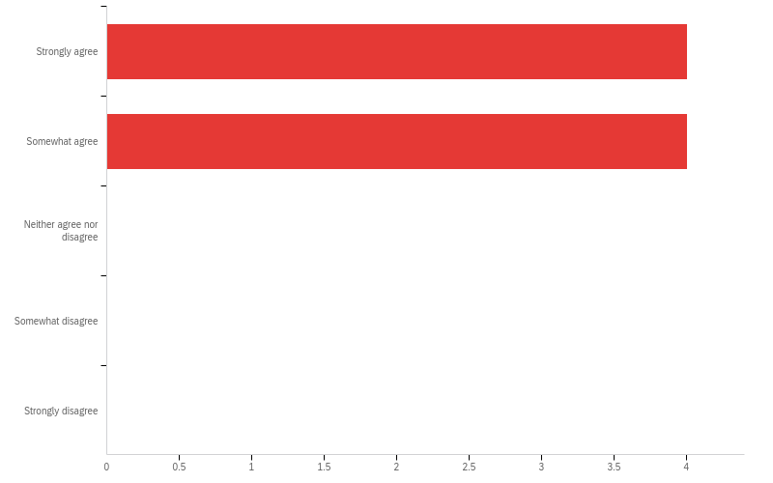
Q6 - Dr. Cheney was interested in my progress

Slide 8
Q7 - Dr. Cheney was up-to-date with current clinical practices

Slide 9
Q8 - Dr. Cheney provided useful information to help my skills develop

Slide 10
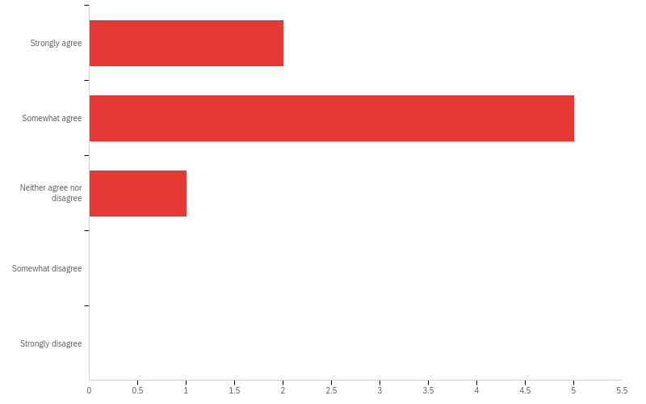
Q9 - Dr. Cheney gave timely and constructive feedback

Slide 11
Q10 - What were the best aspects of Dr. Cheney's teaching?
What were the best aspects of Dr. Cheney's teaching?
Dr Cheney's hands-off approach to teaching has enabled me to think for myself, instead of relying heavily on others.
Patient, approachable
Dr Cheney employs a hands-off approach towards teaching, which is something I appreciate as it gives me the opportunity to think/brainstorm independently.
Dr. Cheney strikes a great balance between offering feedback and support while giving us the autonomy to treatment plan and provide care in areas where we feel confident.
Dr Cheney has fostered a positive environment within the program that has provided us with confidence and the opportunity to learn from herself, my peers and her local and international paediatric specialists. She is incredibly considerate of us students and we appreciate what she does for us.
Very patient with helping us to develop skills for treatment planning. Very encouraging and positive learning environment when Dr. Cheney is the demonstrator. Amazing GA experience with Dr. Cheney as the supervising consultant
Wendy is very approachable, empathetic, and supportive in her teaching style. She is always upfront if there there is something she disagrees with or needs improvement, but she delivers her advice in a respectful way and is always open to discussion. She is also the best dental assistant I have ever had in GA!

Slide 12
Q11 - If you could give Dr. Cheney advice on her teaching, what would you say?
If you could give Dr. Cheney advice on her teaching, what would you say?
Dr Cheney should speak more freely and convey criticism on what she is thinking. This would be more beneficial to my learning so I know where I can improve.
Can be more active versus her more passive approach
Not much
Would be great to receive ongoing feedback on any areas in which we can improve on.
Timetable could be released earlier to allow us to better schedule patients, however I can appreciate that there were challenges this year that might have prevented this.
More feedback on sessions if required at the time to make sure that we are progressing in the right direction.
Keep up the great work and please don't retire before I graduate! We are lucky to have you.

Slide 13
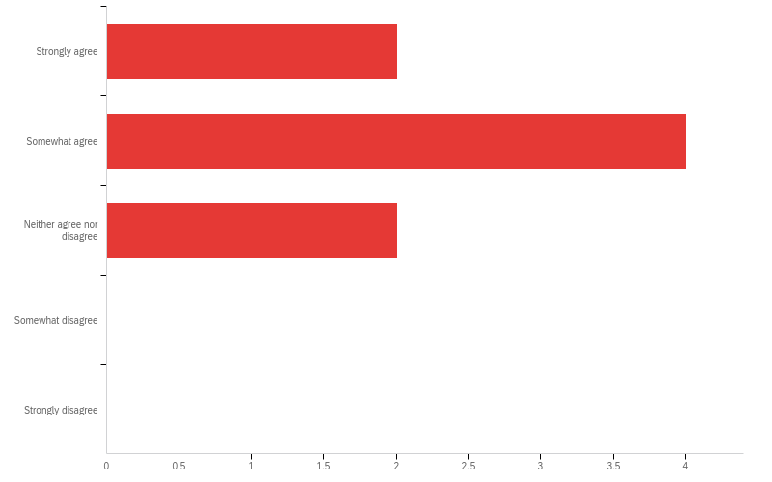
Q12 - Dr. Pandey was readily available

Slide 14
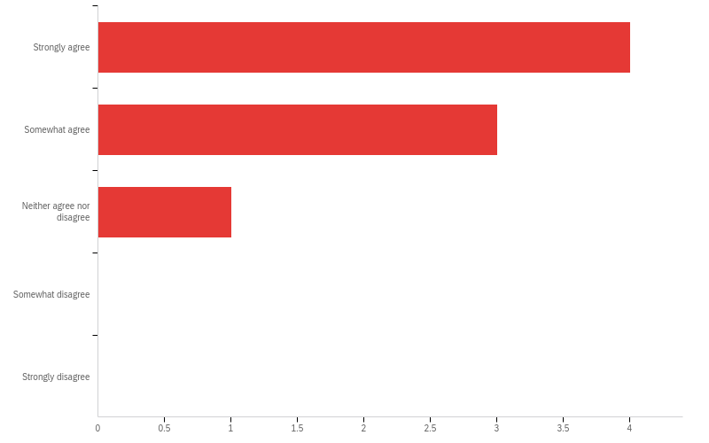
Q13 - Dr. Pandey was patient with my learning

Slide 15
Q14 - Dr. Pandey was interested in my progress

Slide 16
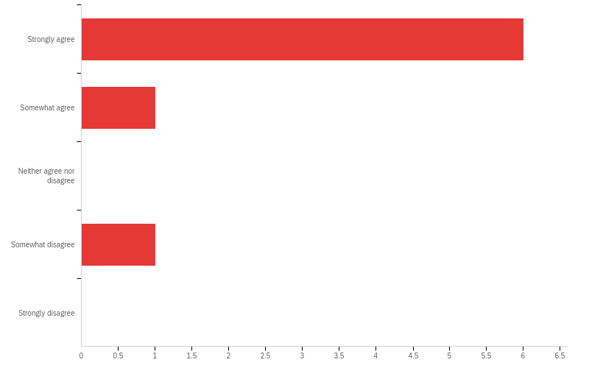
Q15 - Dr. Pandey was up-to-date with clinical practices

Slide 17
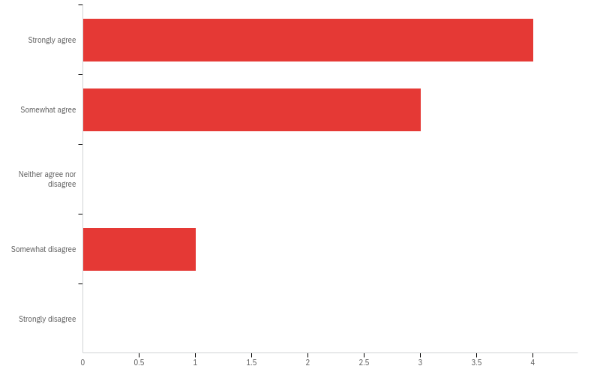
Q16 - Dr. Pandey provided useful information to help my skills develop

Slide 18
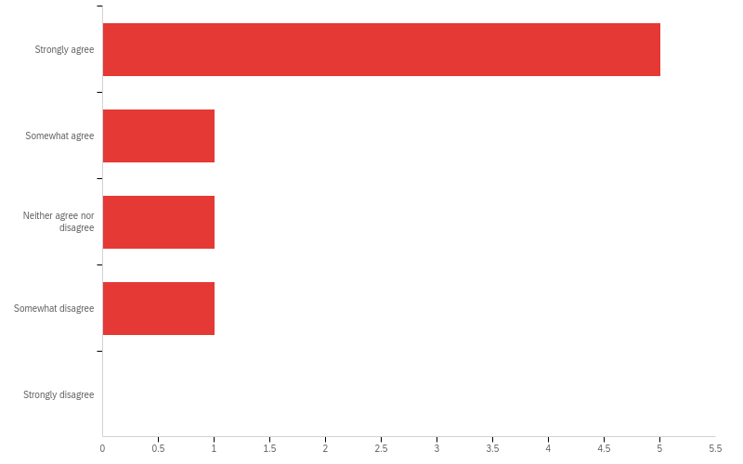
Q17 - Dr. Pandey gave timely and constructive feedback

Slide 19
Q18 - What were the best aspects of Dr. Pandey's teaching?
What were the best aspects of Dr. Pandey's teaching?
Dr Pandey's passion for her students and their learning is appreciated.
Approachable, happy to jump in and assess if you ask
Dr Pandey genuinely cares for her postgrads which makes PG life more bearable.
Dr. Pandey was excellent in GA, offering valuable tips for working more efficiently while providing support and encouragement to help us perform our best.
Dr Pandey is a supportive teacher; she is very proactive with regular constructive feedback. This is valued and helps us keep track of our progress. She is good at setting clear expectations and structure. She has been very supportive in our development.
Gives regular feedback and will acknowledge improvements in areas that have been discussed previously. Very present in GA sessions and helps us to improve time management
Maria is so willing to pass on her knowledge and ensures we have comprehensive learning by providing the 'private practice' perspective that we miss working in the public system.

Slide 20
Q19 - If you could give Dr. Pandey advice on her teaching, what would you say?
If you could give Dr. Pandey advice on her teaching, what would you say?
Dr Pandey could be focus on providing clinical feedback during clinic hours, and use non-clinic hours to discuss other personal matters.
Please try and listen when we are presenting cases because half way through you will interrupt and I lose my train of thought and then the sequence you prefer the information to be presented in gets out of order, which will reflect badly on me. Please do not count me down in 30 second increments during GA. In no way is it helpful to my learning or otherwise. Happy to be timed, very important, but please find another way
Dr Pandey sometimes changes her mind on some treatment decisions.
Nil specific
It can be challenging to find time to discuss cases or complete paperwork with Dr Pandey's availability. I feel I could learn more from her if provided with the time.
More constructive feedback as sometimes it can be presented in a way that is critical rather than constructive.
No areas for improvement - I am grateful for her time and support, particularly in teaching practical skills and preparing us for viva presentations.

Slide 21
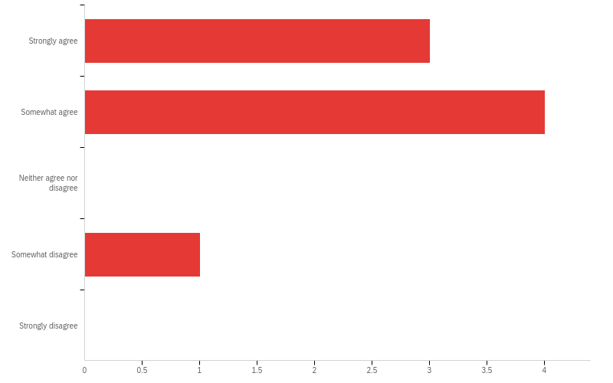
Q20 - Dr. Andreasen-Cocker was readily available

Slide 22
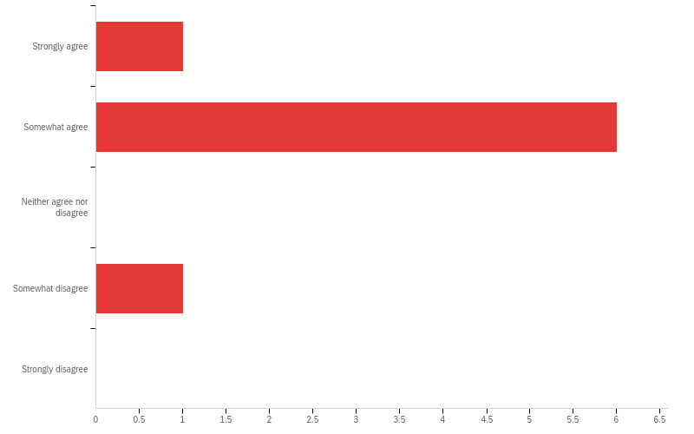
Q21 - Dr. Andreasen-Cocker was patient with my learning

Slide 23
Q22 - Dr. Andreasen-Cocker was interested in my progress

Slide 24
Q23 - Dr. Andreasen-Cocker was up-to-date with clinical practices

Slide 25
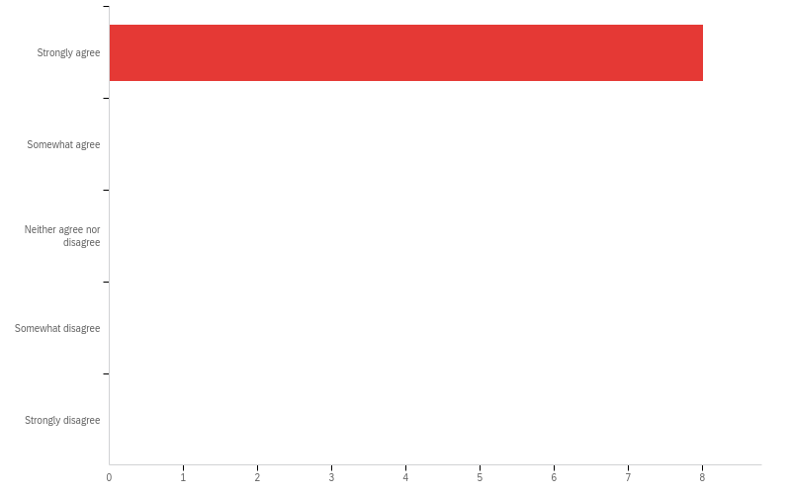
Q24 - Dr. Andreasen-Cocker provided useful information to help my skills develop

Slide 26
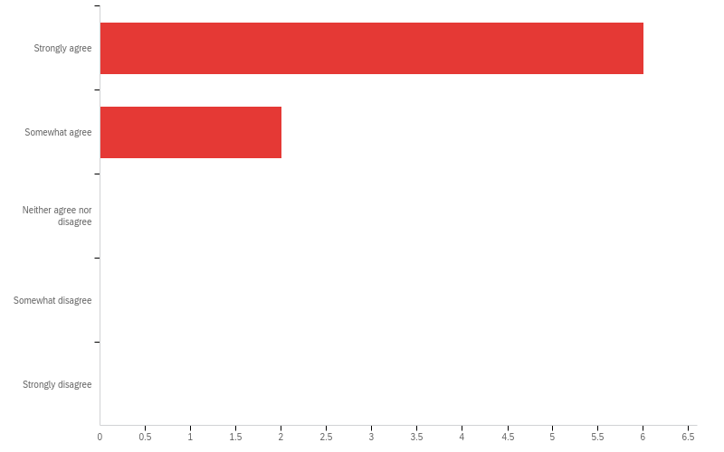
Q25 - Dr. Andreasen-Cocker gave timely and constructive feedback

Slide 27
Q26 - What were the best aspects of Dr. Andreasen-Cocker's teaching?
What were the best aspects of Dr. Andreasen-Cocker's teaching?
Dr Andreasen-Cocker is a daring clinician with surgical experience and it is a pleasure to watch/be guided by him.
Will let you
Dr Andreasen-Cocker loves teaching and I enjoy how he explains things.
Dr Andreasen Cocker identifies areas that need improvement, and immediate feedback in the sessions.
Dr Andreasen-Cocker is an incredibly knowledgable teacher. He is a skilled operator and teacher of oral surgery; which is a great asset. His approach to teaching by questioning or challenging our decision making processes enhances our learning.
Always happy to discuss cases and teach especially with surgical cases and CBCT. Very supportive of our learning and wellbeing as students
Perfect example: last week Dan was running multiple theatres, we had had a day of difficult cases, and theatre was an hour behind schedule, yet he made the effort to talk me through every step of each procedure and made time to give me constructive feedback at the end of the session.

Slide 28
Q27 - If you could give Dr. Andreasen-Cocker advice on his teaching, what would you say?
If you could give Dr. Andreasen-Cocker advice on his teaching, what would you say?
Dr Andreasen-Cocker appears to get flustered/frustrated when things do not go smoothly, and this can show.
Please be patient, first years are not third years and third years are not first years so we are all at different stages and have different amount of knowledge and experience. Would like to learn more from him but not sure he has the patience for first years
Sometimes if Dr Andreasen-Cocker is having a more difficult day, it can show indirectly.
He can sometimes become impatient and step in, which can make working with him stressful. It would be beneficial if he allowed students more opportunities to apply his feedback independently.
Dr Andreasen-Cocker's style of teaching is most beneficial in second semester of first year and beyond in our training. His GA list is quite challenging and tightly booked; it can be a difficult environment to introduce a postgraduate to a theatre environment. As a result, if on this list in first year semester, there is not enough time or focus on training on basic GA fundamentals. This can result in limited teaching moments for the post-grad and stress or frustration for Dr Andreasen-Cocker
More patience during the initial stage of learning how GA works and the processes to follow

Slide 29
Q27 - If you could give Dr. Andreasen-Cocker advice on his teaching, what would you say?
If you could give Dr. Andreasen-Cocker advice on his teaching, what would you say?
No advice to give - I am thankful for his enthusiastic teaching style and how readily available he is to discuss all areas of patient care (eg. patient management, social factors, CBCTs).

Slide 30
Q28 - Dr. Kilpatrick was readily available

Slide 31
Q29 - Dr. Kilpatrick was patient with my learning

Slide 32
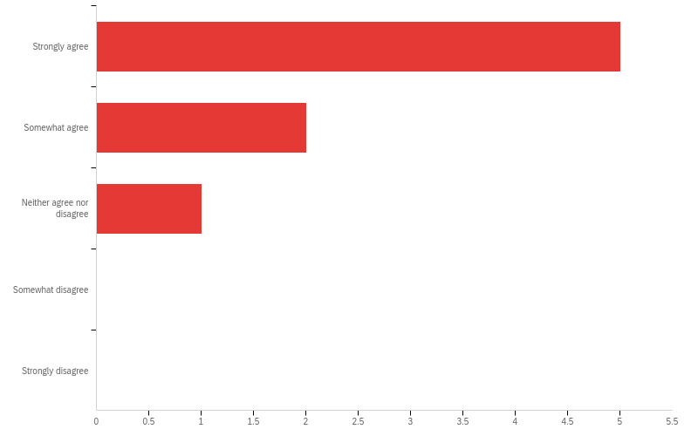
Q30 - Dr. Kilpatrick was interested in my progress

Slide 33
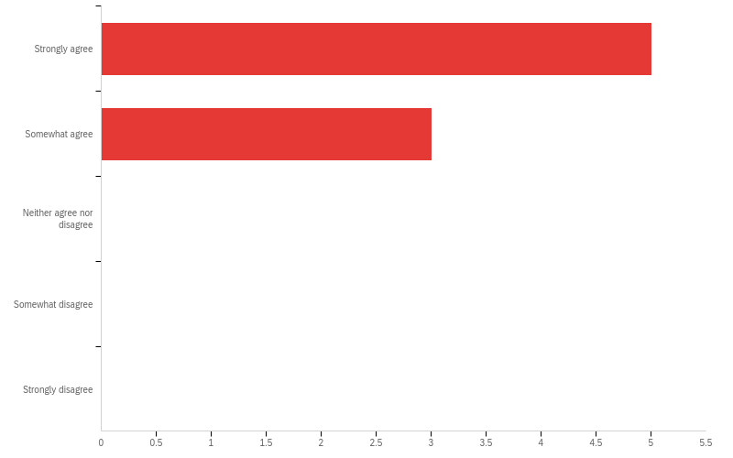
Q31 - Dr. Kilpatrick was up-to-date with clinical practices

Slide 34
Q32 - Dr. Kilpatrick provided useful information to help my skills develop

Slide 35
Q33 - Dr. Kilpatrick gave timely and constructive feedback

Slide 36
Q34 - What were the best aspects of Dr. Kilpatrick's teaching?
What were the best aspects of Dr. Kilpatrick's teaching?
Dr Kilpatrick is humble, patient and has a wealth of knowledge and experience. She is able to teach in a genuine and non-condescending way which I appreciate.
So patient and kind and constructive when giving feedback and asking you why this, why that when presenting your treatment plan, genuinely interested in your progress
Dr Kilpatrick provides a very supportive environment where I feel it is easy to ask questions without feeling apprehensive. She also has a wealth of knowledge and experience and also seems very relatable.
Dr Kilpatrick is extremely friendly and approachable, which makes it easy to discuss cases with her and ask for advice when unsure.
Dr Kilpatrick is a great teacher and leader that has contributed towards a positive learning environment. Her ongoing passion for learning and collaboration is contagious. Her feedback is timely and constructive, I feel that I have learned a great deal from her.
Very patient and supportive learning environment. Always happy to have a healthy discussion and challenge our thinking
Nicky is wealth of knowledge and is very passionate about paediatric dentistry. I enjoy her debates and the fact that we can disagree on a topic yet have an extremely enjoyable conversation; she makes me think and consider different perspectives.

Slide 37
Q35 - If you could give Dr. Kilpatrick advice on her teaching, what would you say?
If you could give Dr. Kilpatrick advice on her teaching, what would you say?
None
Please don’t leave until we finish (all of us!)
Not much.
Would be great if we received ongoing feedback on areas that need improvement.
Would appreciate more time to learn from Dr Kilpatrick in a clinical setting
Do not change a single thing - you are an excellent teacher and a wonderful mentor.

Slide 38
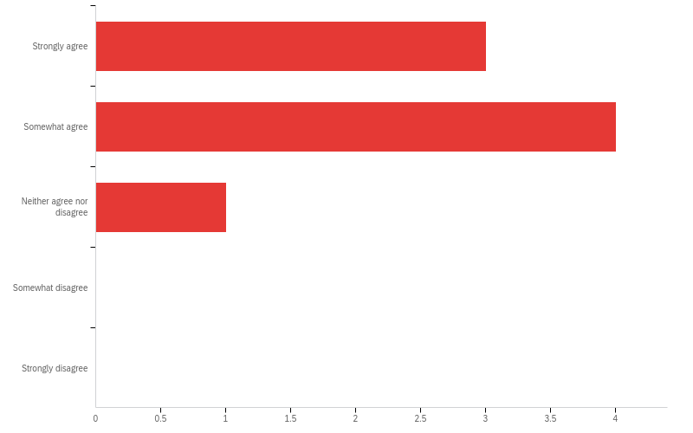
Q36 - The RCH staff were readily available

Slide 39
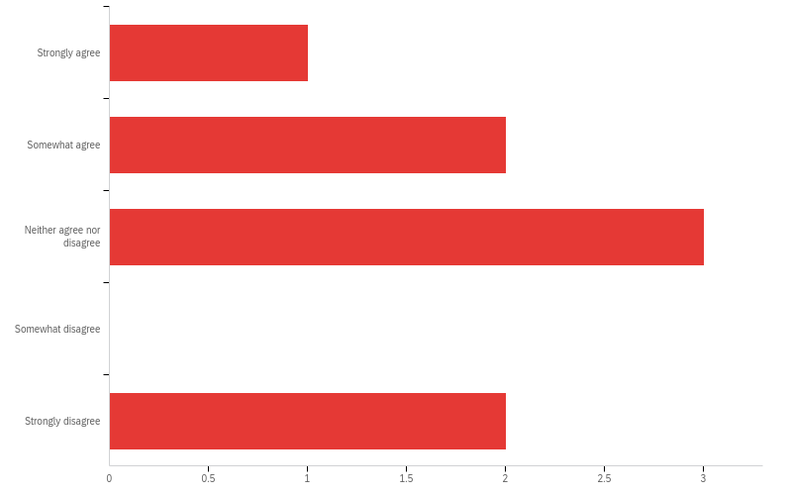
Q37 - The RCH staff were patient with my learning

Slide 40
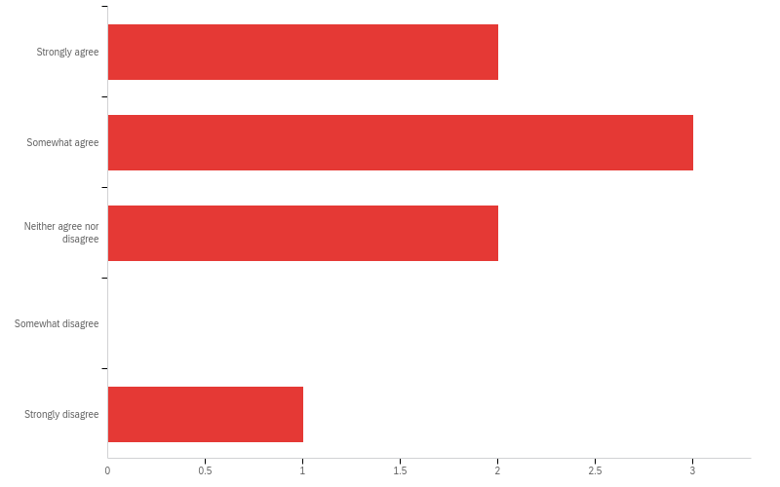
Q38 - The RCH staff were interested in my progress

Slide 41
Q39 - The RCH staff were up-to-date with clinical practices

Slide 42
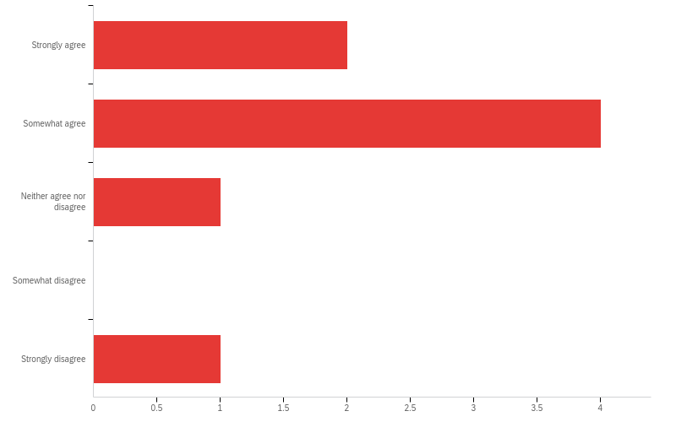
Q40 - The RCH staff gave me useful information to help my skills develop

Slide 43
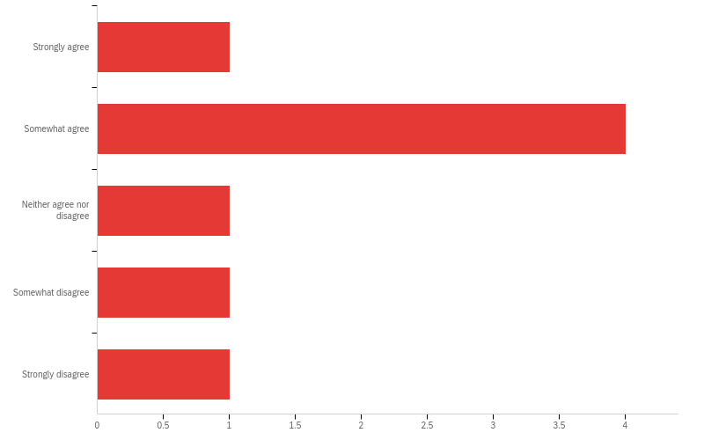
Q41 - The RCH staff gave timely and constructive feedback

Slide 44
Q42 - What were the best aspects of RCH staff teaching?
What were the best aspects of RCH staff teaching?
The environment at RCH is beneficial to my post-graduate studies as a whole - due to the exposure of a wide array of medical conditions. However, there is not a lot of clinical treatment being undertaken, rather a lot of reviews which
It’s a fantastic opportunity to learn about trauma and medically compromised children but unfortunately there is nothing I enjoy about the RCH teaching, it’s all very humiliating and condescending, except for Dr Luke Moloney who is very patient and willing to jump in and give you tips and tricks if you need
RCH staff have a lot of experience in complex medical issues.
RCH is a busy place, and the supervisors always make time to provide support and assistance with cases, despite their busy and hectic schedules. We really appreciate them doing this for us.
RCH is an environment that enforces a high level of preparation and critical thinking. I feel my time at RCH has pushed me to be more discerning and critical of my own abilities and my clinical judgement. I feel this has ultimately made me a better and more informed clinican. There is an emphasis on team work and the staff have been welcoming.
Medical series was very interesting and helpful. Dr. Luke Moloney is a great teacher. Encouragement for self-directed learning.

Slide 45
Q42 - What were the best aspects of RCH staff teaching?
What were the best aspects of RCH staff teaching?
Learning how to manage patients with complex medical needs.

Slide 46
Q43 - If you could give advice to RCH staff on their teaching, what would you say?
If you could give advice to RCH staff on their teaching, what would you say?
Some of the RCH staff could be more patient and more readily give their knowledge without feeling belittled.
Please be kind and compassionate and patient. If you want me to come with a curious mind and I do, I prep as best I can to get all the information on whatever obscure piece of the puzzle you may require (often just to point out that I don’t know something not because you are genuinely interested in my learning and how this will affect my clinical judgement), I still don’t have all the answers, don’t punish me for it. I am still learning and you are meant to be teaching me, not belittling me and making me so unenthusiastic and anxious about my sessions there so I don’t even want to ask any questions.
I feel it is difficult to ask questions for learning, there is a general atmosphere that asking questions feels inappropriate. I would like to be able to ask more questions without feeling apprehensive as all the staff have extensive medical knowledge on the vast range of conditions at RCH.
Ongoing feedback on areas that need improvement, but also offer students an opportunity to implement this feedback and demonstrate improvement.
The high calibre of consultants, standard of care and complexity of the children at RCH alone are intimidating. Neither myself or my peers want to let our consultants or our patients down. However, given the most recent issues our peers have had at RCH, we are increasing anxious, fearful of being wrong, making a mistake or saying something silly. This is negatively affecting myself and my peers confidence and openness.

Slide 47
Q43 - If you could give advice to RCH staff on their teaching, what would you say?
If you could give advice to RCH staff on their teaching, what would you say?
More constructive feedback if there are things you aren't sure about and a open environment where asking questions is encouraged
Provide calm and constructive feedback during or immediately after the clinical session, and be more approachable. The current teaching style is one of condescension and frustration; I do not feel like I can ask questions without receiving judgement for not already knowing the answers. While RCH is an important aspect of DCD, it is not an environment that is conducive to learning.

Slide 48
Q44 - The specialty clinic in endodontics with Professor Parashos was instrumental to my learning in this field

Slide 49
Q45 - Please make comments/suggestions about the specialty endodontics clinic
Please make comments/suggestions about the specialty endodontics clinic
None
If we could share around some endo cases so everyone gets a good spread, that’d be great, especially the rarer ones, regen/apexification/root burial
I love the specialty clinic in endodontics! Professor Parashos is so knowledgeable and passionate. I would like to be able to have more sessions (as I have many endodontic patients).
Nil specific
I am incredibly grateful for Prof Parashos' generosity with his time and insight. His sessions are incredibly valuable and I have learnt a great deal from him. I only wish we had more sessions.
Great clinic. Having additional nitrous availability would be helpful
We need more access to nitrous oxide sedation. Prof has been very helpful both during and outside of the speciality endodontic clinic in assisting with endodontic cases.

Slide 50
Q46 - The specialty clinic in interceptive orthodontics with Dr. Bokas was instrumental to my learning in this field

Slide 51
Q47 - Please make comments/suggestions about the interceptive orthodontic clinic
Please make comments/suggestions about the interceptive orthodontic clinic
We are being guided and told (nicely) what to do, but sometimes I don't understand 'why' I'm doing it as I feel the clinic is too busy to ask questions.
Same as endo clinic…please could we share
I also love the interceptive orthodontic clinic! It feels quite busy at times which may be overwhelming for Dr Bokas, but his time is very appreciated. The only suggestion I would have, is allowing time for the PG to think or explain why a certain treatment decision is made or a certain treatment is being performed.
Really enjoyed the viva practice sessions at the end of the year and feel this helped improve our learning and understanding of ortho a lot! Think we would benefit from doing these more regularly.
I am very grateful for the time Dr Bokas commits to our learning. His sessions are valued and enhanced by understanding of interceptive orthodontics. I am very appreciative of the time he spends after-hours assisting us. I feel the frequency of this clinic is appropriate.
Jim is very supportive of our learning. Clinic can get very busy if there is lots of treatment but this seems to have improved over the past few sessions.

Slide 52
Q47 - Please make comments/suggestions about the interceptive orthodontic clinic
Please make comments/suggestions about the interceptive orthodontic clinic
It is a well-run clinic with no improvements to be made. Jim has been extremely generous with his time and has explained orthodontics in a logical manner that is readily applicable to paediatric dentistry.

Slide 53
Q – Please comment on you experience at Rumbalara
Rumbalara was really great. I really enjoyed being there and I think being able to do the assessments for DSU was very valuable for a lot of the patients where transport to Melbourne for multiple appointments is an issue.
I think being there for longer than 2 days would be more beneficial for the clinic because we can then treatment plan and complete some of the treatment rather than treatment plan for the other staff to complete. We can also hopefully give them more nitrous appointments during that week.

Slide 54

Q48 - The week-long anesthesia rotation I participated in during 2022 or 2023 was instrumental to my learning in this field

Slide 55
Q49 - Please make comments/suggestions about your anesthesia experience
Please make comments/suggestions about your anesthesia experience
None - would have liked a broader variety of anaesthetists to shadow, however I understand that some anaesthetists may not be comfortable in being shadowed.
Would be useful to get an idea of what to say to parents when they ask the tricky questions. Great to know what the anesthetists would like to know from the surgeons. How anesthetics works in private practice
I enjoyed my anaesthetic rotation. I only shadowed 3 different anaesthetists, I feel like I would have loved to shadow a wider variety of anaesthetists.

Slide 56
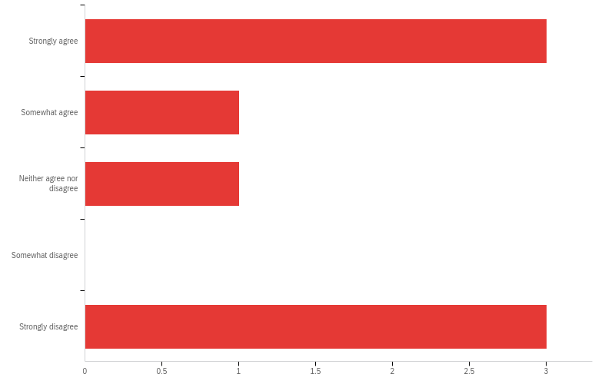
Q50 - The DDS clinical and preclinical teaching I participated in was a valuable experience

Slide 57
Q51 - Please make comments/suggestions about your DDS clinical and preclinical teaching experience
Please make comments/suggestions about your DDS clinical and preclinical teaching experience
This is a waste of my time as a paying DCD student - with fees over over $55,000. This time is better spent as research or even observing other paeds in GA or in the clinic. This is not valuable experience.
Didn’t enjoy this much…not enough treatment, too many exams. Is it possible for them to observe us for a session and then apply their skills in clinic
I would rather have research time.
Nil specific
This opportunity allows us to consolidate our learning through teaching; this is appreciated and valued. Dr Loo's passion for teaching is infectious.
Good experience
I learnt a lot from listening to Dr Siew May Loo, and having the opportunity to teach helps solidify my own understanding.

Slide 58
Q59 - Please comment on your experience with the Common Core - run for the first time in 2024
Please comment on your experience with the Common Core - run for the first time in 2024
Not too many thoughts - sometimes some cases are too tedious as other specialties seem to question each other for the sake of questioning.
It has potential to be good. Maybe each discipline could give a presentation on something specific to their speciality and teach the rest of us. Not sure if cases were the best way to do this.
? applicability of some sessions for Paediatric Dentistry. Closer collaboration ie JOP may be more useful for Paeds.
Several sessions were outside the scope of Paeds.
Case discussions were highly valuable and interesting. Some lecture topics failed to include Paediatric Dentistry at all, however I can appreciate how this would be a challenge.
Nice to see the other disciplines regularly
It is admirable what Common Core is theoretically trying to achieve, however I personally didn't find it useful to my learning. As this course is very demanding for time, I feel it could have been better spent on other learning.

Slide 59
Q52 - The Wednesday morning seminars were well-coordinated

Slide 60
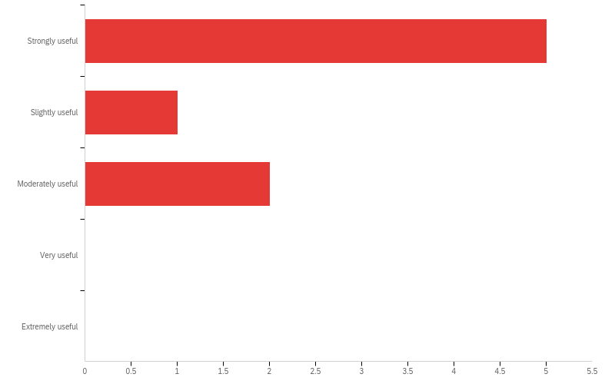
53 - The teaching was supported by useful learning resources

Slide 61
Q56 - The assessments were fair and useful for my learning

Slide 62
Q54 - I learnt new ideas/skills that I could apply to practice

Slide 63
Q55 - I felt part of a group committed to learning

Slide 64
Q57 - What were the best aspects of this subject?
What were the best aspects of this subject?
It is nice to get together and bounce ideas and experiences off each other.
The various contexts of which the students are exposed to. A well rounded mixture between didactic, research and practical teaching. Outreach rotation to Rumbalara. Please continue Ortho and Endo specific clinics these are very valuable learning sessions.
Loved being part of the group discussions this year, and some of them really challenged our understanding of concepts which was great!
This subject combines a good amount of practical and theoretical learning. There is an emphasis on obtaining knowledge and applications in clinical practice. Our consultants and clinical demonstrators are a highlight of this program.
Cohesive group which fosters a good and supportive learning environment. Case presentations are really helpful to learn about other students clinical experience. Seminar structure is great and encourages regular review of the literature
Clinically, GA - it is the most beneficial aspect to our learning as we get practical experience in an environment where you can talk through a procedure with a consultant by your side. For didactics - I enjoyed the case presentation assignments as they provide the opportunity to thoroughly learn a topic and investigate the current literature.

Slide 65
Q58 - What aspects of this subject do you believe should be improved?
What aspects of this subject do you believe should be improved?
If there are readings, it would be great if they could be sent well in advance.
I think giving one paper & getting everyone to critically appraise it would work well, I still feel like I don’t know the strengths & weaknesses of a paper well. Is this something Mihiri would be willing to lead. Some presentations are too long - and no one steps in to say 5 mins left or whatever. Please get them to stick to time, it’s important we know how to present well with the time given to us. I liked it when we are able to ask questions through the presentation instead of wait until the end. When people are presenting please remind others to listen, not be madly typing away on their laptops
RDHM GA lists to be grouped as a block - for continuity ie once/twice a week for an entire month at a time. This allows for the student to practice deficiencies identified by the consultant within that same month. First aid training (Paeds specific ? )to be integrated into DCD course ie during orientation? CBCT interpretation course. Exposure to Zirconia crown preparations - may be integrated into private practice sessions. Some basic knowledge around Temporary anchorage devices, basics of implant placement - Orthodontists may want our assistance and for us to place TADs whilst patients are under GA. Incorporation of communication skills courses - ie managing children with procedural anxiety. Wednesday morning introduction to RCH sessions for first years - may be more beneficial to be introduced with a greater mixture of clinicians and consultants, perhaps one week at a time with a period of shadowing upper years, like how RDHM GA was introduced.

Slide 66
Q58 - What aspects of this subject do you believe should be improved?
What aspects of this subject do you believe should be improved?
Did not find the orthodontic reading resources this year were very helpful.
Increased access to GA and nitrous oxide inhalation sedation would be of great value.
More GA time if possible. The opportunity to assist consultants for their own clinical work (restorative and surgical) as I feel I could learn a lot from observing their patient management techniques.

Slide 67
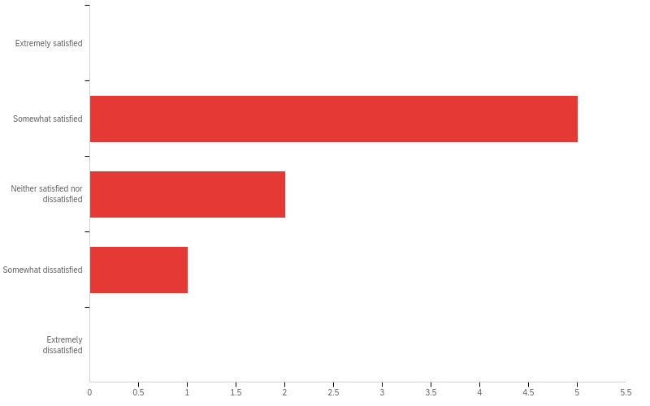
60 - How satisfied are you with the Research Component of this course?

Slide 68
Q61 - What are the best aspects of the research component?
What are the best aspects of the research component?
Dr Silva is the best part of the research component as she is an excellent supervisor and guide towards what needs to be done
Didn’t feel like I learned much or contributed much
Dr Mihiri is an excellent supervisor.
Dr Silva was invaluable in guiding us through the research component. Lectures provided a nice introduction to research.
Mihiri is great
The support from my supervisors.

Slide 69
Q62 - What aspects of the research component do you believe should be improved?
What aspects of the research component do you believe should be improved?
None
Focus on critical appraisal of papers so we can read a paper and weigh up if it was done correctly, however I really think someone with a research background needs to head this up. It’s so important as specialists to be able to critically investigate new claims that are coming out so it can inform our practice. This would be much more useful than spending 6 months submitting and resubmitting ethics…which teaches me nothing useful
Paediatric Dentistry post-grads seem to be much more prepared than other specialties. However, it is clear that there is a lack of consistency across the specialties and the DCD research requirements. Classmates found it difficult to adapt the research subjects requirements to the existing progress they had made ie to condense a Scoping Review progress into 4000 word requirement for the research course is counter intuitive and a waste of time. There needs to be exceptions for these cases.
Research can often be challenging, so it would be helpful to have more regular group sessions that foster discussions among students. These sessions could allow us to share challenges we’re facing in our projects, exchange knowledge, and learn from one another.
Organisation of assessment tasks could have been improved. A few assessment tasks did not have rubrics provided or clear descriptions of what the task itself was.

Slide 70
Q62 - What aspects of the research component do you believe should be improved?
What aspects of the research component do you believe should be improved?
Not all the assessments were relevant for the stage of the research. Biostats course was quite complicated even though it was for beginners. Research lectures were not always that useful
The research course itself felt like a chore rather than assisting me with my thesis. My time would have been better spent completing things one-on-one with my supervisor rather than completing assignments for the research course.

Slide 71

Q63 - How satisfied are you with your decision to become a paediatric dental specialist

Slide 72
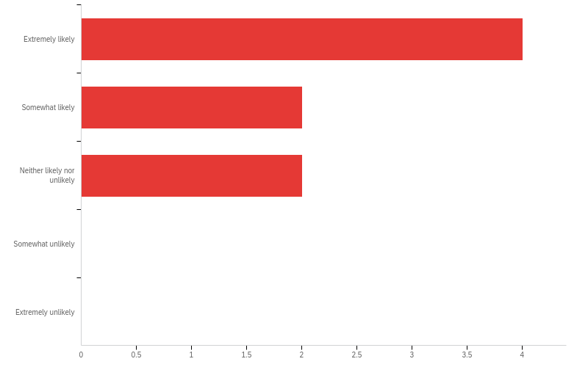
Q64 - How likely would you be to recommend this program to interested colleagues

Slide 73
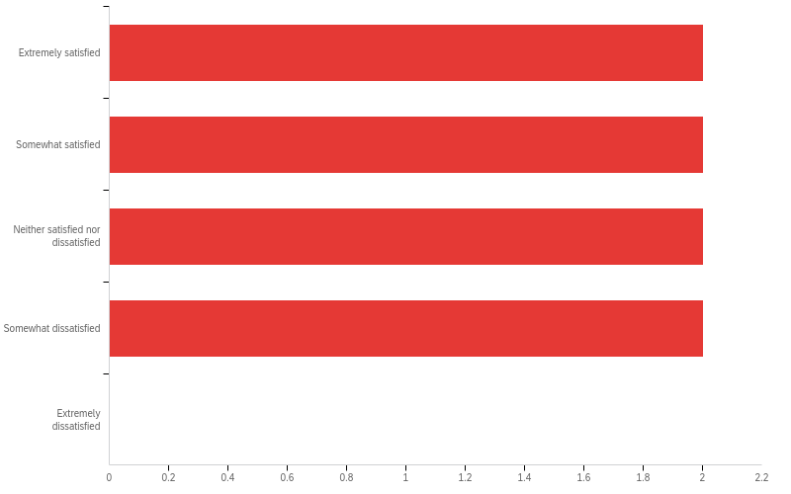
Q65 - How satisfied are you with your overall experience at the University of Melbourne

Slide 74
Q66 - Please feel free to provide further feedback on any aspect of the program
Please feel free to provide further feedback on any aspect of the program
I feel disappointed that a lot of clinical learning will need to be done after graduation I.e. Graduating having only done one pulpotomy or one surgical removal of a supernumerary etc. I feel disappointed that there is no opportunity to learn zirconia crowns, even on fake models, as we are meant to be learning 'up-to-date' skills and techniques. I feel disappointed that I won't feel prepared clinically for private practice when I graduate but have accepted this. Overall, it's disappointing as this course is over $150,000 and many of us have put our lives on 'hold'/relocated to pursue this degree at this University. Also, I feel burnt out from doing on call, particularly as there was a period of 7 months (April-October 2024) when there was only FOUR postgraduate students allowed to do on call (2x 3rd years, 2x 2nd years). This was extremely tiring as there was minimal help from RCH staff for on call, despite them voicing they wanted to help by doing some additional days, however when asked, they did not offer. I understand that on call is part of our training, but normally there are SIX postgrads doing on call, and during that 7 month period when there was only 4 of us - I felt tired and burnt out during this period and felt there was no acknowledgement of this, just that it is expected of us. However, the people in the course, including the staff (Drs Cheney, Kilpatrick, Andreasen-Cocker, Pandey) - I have felt they genuinely care about our journey to become paediatric dentists and to be able to think for ourselves. I also feels grateful that the majority of this current cohort are kind and are team players. I feel that I have made some friends for life.
I feel we are extremely unprepared for private practice, where parents are very interested in saving teeth & white crowns. There needs to be provision to learn and practice these skills because this is what people want in the real world. I don’t feel it’s acceptable to say it’s public practice therefore we can’t do a, b and c. Maybe put some of the onus back on us so we also take responsibility for the case and need to follow up. We need mu ch more experience with pulpotomies, pulpectomies, space maintainers, white crowns because we’re going to get out and have no idea how to execute these skills proficiently. There needs to be teaching cases which allow this. I would expect more from my specialist paediatric dentist as a parent other than extraction. If consultants are not interested in teaching please don’t make them, it is detrimental to my learning, or atleast provide them with some sort of training as to how to teach properly

Slide 75
Q66 - Please feel free to provide further feedback on any aspect of the program
Please feel free to provide further feedback on any aspect of the program
Administrative support at RDHM needs to be improved - it is futile for PLOs to be notifying the clinician to re-book when families have contacted the hospital to re-schedule straightforward recall appointments clearly identified in the patient's file. If it is not clear in the notes - definitely fair to notify the clinician. Remote access to Titanium would be hugely beneficial for all students and to improve efficiency and preparedness for cases/case presentations. This will assist with administrative burden which is arguably the most low yield exercise of the RDHM experience. Additional staff to facilitate more nitrous units must be a priority for the Paediatric Dentistry department.
I’ve thoroughly enjoyed being part of a fantastic group and have found Dr. Wendy, Dr. Nicky, the RCH staff, Dr. Dan, and Dr. Maria to be incredibly supportive and inspiring. However, the administration staff at the University have made the course more challenging than necessary. One suggestion for improvement would be to group GA sessions (e.g., three consecutive sessions per consultant) to allow us time to learn from a consultant’s specific teaching style and techniques, implement their guidance, and refine our skills before transitioning to another consultant with a different approach. This structure would help us process and adapt to individual techniques more effectively while also identifying what works best for us. I did not find the RCH GA sessions particularly helpful this term and believe fewer RCH GA sessions should be included in the schedule. Finally, I want to give special recognition to Dr. Kris, who stands out as one of the most supportive and non-judgmental consultants, not mentioned in this form. He consistently provides impressive, constructive feedback in every session and has been very committed to our learning.

Slide 76
Q66 - Please feel free to provide further feedback on any aspect of the program
Please feel free to provide further feedback on any aspect of the program
Given the University of Melbourne financially supports it's postgraduates the least compared to its other Australian counterparts, focus needs to be placed on retaining consultants or teaching staff (they are the reason we select this program) and/or discussions with DHSV who fail to recognise us as employees.
MDC is good for the first 6 months as it gives good 2:1 support for treatment planning and presenting to the consultant. It does not feel as productive in 2nd semester especially as there are often not many patients. Feedback 4x year would be helpful for progress reports (in a less formal manner than at the end of each semester - like what Nicky or Kris do with things that are going well and things to improve on)
It would be wonderful to have more comprehensive exposure to paediatric dentistry procedures (eg. pulpotomies, strip crowns, zirconia crowns, space maintainers). I know Wendy and Dan are doing their best to facilitate this, but if the University of Melbourne could provide further support this would allow us to graduate as well-rounded clinicians.

